Slide 1


Slide 2

AGENDA
Agenda, February 6,2019 CA President’s Chat
Welcome and Approval of Agenda – Link Glenda
Friendship Moment – Link Monica
Area Director Report – Link Glenda
Area Vice Director Update – Link Monica
Secretary Update – Link Jill
Treasurer Update – Link Sheila
Foundation Report – Link Tara
Nominating Update - Link Joyce
Program Update – Link Lauren
OE Report – Link Sharilyn

Slide 3
Area Directors Report
  I represented the Area at our National Headquarters at the inaugural dedication of co Founders photographs. The photos were a gift to the Arlington (VA) chapter who in turn gifted them to the organization. All eight living Presidents were a part of the ceremony. I was the 9th witness to the dedication.
  The new ritual was written by Link Cynthia Jenkins-Hightower, Shreveport (LA) and National Rituals Chair. This new ritual is open to the public and can be used on the chapter level.
  On Friday night, at a “Heart Health” educational program for women in the DC Metropolitan area more than 1,000 individuals attended the “Red Dress” event. Below is a picture including all eight living past national presidents of the Links, Incorporated.
  The first planning meeting for the 2019 Area Conference was held in Nashville in January. The Nashville Cluster is in high gear and working very hard to plan an Area Conference that you will not soon forget.

Slide 4
Area Directors Report
  Area Conferences are as follows:
    Eastern Area April 24-28, 2019. Atlantic City, NY
    Southern Area May 1-6, 2019. Orlando, FL
    Western Area June 5-9, 2019. Austin, TX
    Central Area. July 31-August 4, 2019 Nashville, TN
  List of quilts contributors are attached. No additional funds will be collected after March 1st
  President’s please stay on the line after the chat is over for second session of President’s certification

Slide 5
Quilt Participants
Ann Arbor
Archway
Chattanooga
Chicago IL
Cincinnati
Circle City
DesMoines
Detroit
Flint
Fort Wayne
Frankfro/Lexington
Great Lakes
Greater Kansas City
Harbor Lite
Hoffman Estate Chapter
Kalamazoo
Knoxville
Lake Shore
Minneapolos St Paul
NW Arkansas
Oklahoma
Omaha
Parthenon
Quad Cities
River City
South Suburban
Springfield
Topeka
Twin Rivers
Wilberforce
Windy City
Youngstown

Slide 6
Area Directors Report
The Links London (UK) Chapter invite you to attend the world's most glamorous racing day - Ladies Day at Royal Ascot. This is renowned for being the biggest day on the British social and sporting calendar, and we are delighted to host our Link sisters to be a part of this exciting occasion. This will be a fantastic day to join the regal tradition, pageantry but more importantly to strengthen our friendships
In addition to Ladies day at Royal Ascot, we will also host a number of other events over the course of 4 days in London. The Itinerary starts on the 19 June until the 22nd June 2019.
Tickets can be purchased here:
https://linksroyalascot.shoobs.com/
Itinerary
19 June
Champagne Reception & Luxury brands shopping (Included In Ticket Price)
The Links London (UK) Chapter welcomes you to London with a Champagne Reception in Mayfair, the heart of Luxurious London. Please join us for an evening of Live Jazz, whilst enjoying the finest champagne, gin cocktails and hors d'oeuvre. During the evening, there will be a number of luxury brands showcasing just for you, giving you the opportunity of a fabulous personal shopping experience.

Slide 7
Area Directors Report
20 June
Historical Royal Ascot Ladies Day (Included In Ticket Price)
Our fabulous day at Royal Ascot will include:
Return luxury coach transport to Royal Ascot from London
Welcome to the Royal Ascot Village EnclosurePimm’s No1 drinks reception ( Complimentary beer, wine, spirits & soft drinks)
Four-course luncheon
The Royal Procession
Enjoy the spectacular Racing (With prizes totalling more than £7 million)
Afternoon tea served from buffet stations
Entertainment, an array of live music acts
22 June
Yacht cruise on the Silver Sturgeon (Included In Ticket Price)Enjoy 4 hours of pure luxury while cruising down London's River Thames. You will enjoy London scenic skyline and historic buildings, whilst enjoying a 3 Course meal served and Champagne.

Slide 8
Area Directors Report
21 June
Experience London Day ( Add ons - Optional purchase, not included in ticket )
In addition to our 3 day set schedule, we invite you to experience some of London's fantastic sites on the 21st June. Each activity is an optional add on and not included in the set ticket price.
Please register your interest at nationsladies@nationsladies.org.uk for one of the following Add-ons and further information with regard to bookings will be released shortly.
Option A) Sightseeing Bus Tour serving high tea on board.
Option B) Wine Tasting, and afternoon tea at the Strafford Hotel London.
Option C) Clay Pigeons Shooting at a Country Estate.
What to Wear
Dress to Impress! At Royal Ascot, attendees are encouraged to dress in a manner as befits a formal occasion. Ladies are required to wear a hat, and Gentlemen a suit and tie. Strapless or sheer strap dresses and tops are not permitted; Trouser suits and jumpsuits must be full-length; Midriffs must be covered; Shorts are not permitted; Jeans and trainers are not permitted; Bow ties and cravats are not permitted.
Hotels
Please find attached our list of recommended hotels here
The Links London (UK) Chapter are so excited to host you in London! If you have any further questions, please contact nationsladies@nationsladies.org.uk
Tickets can be purchased here:
https://linksroyalascot.shoobs.com/
ᐧ

Slide 9
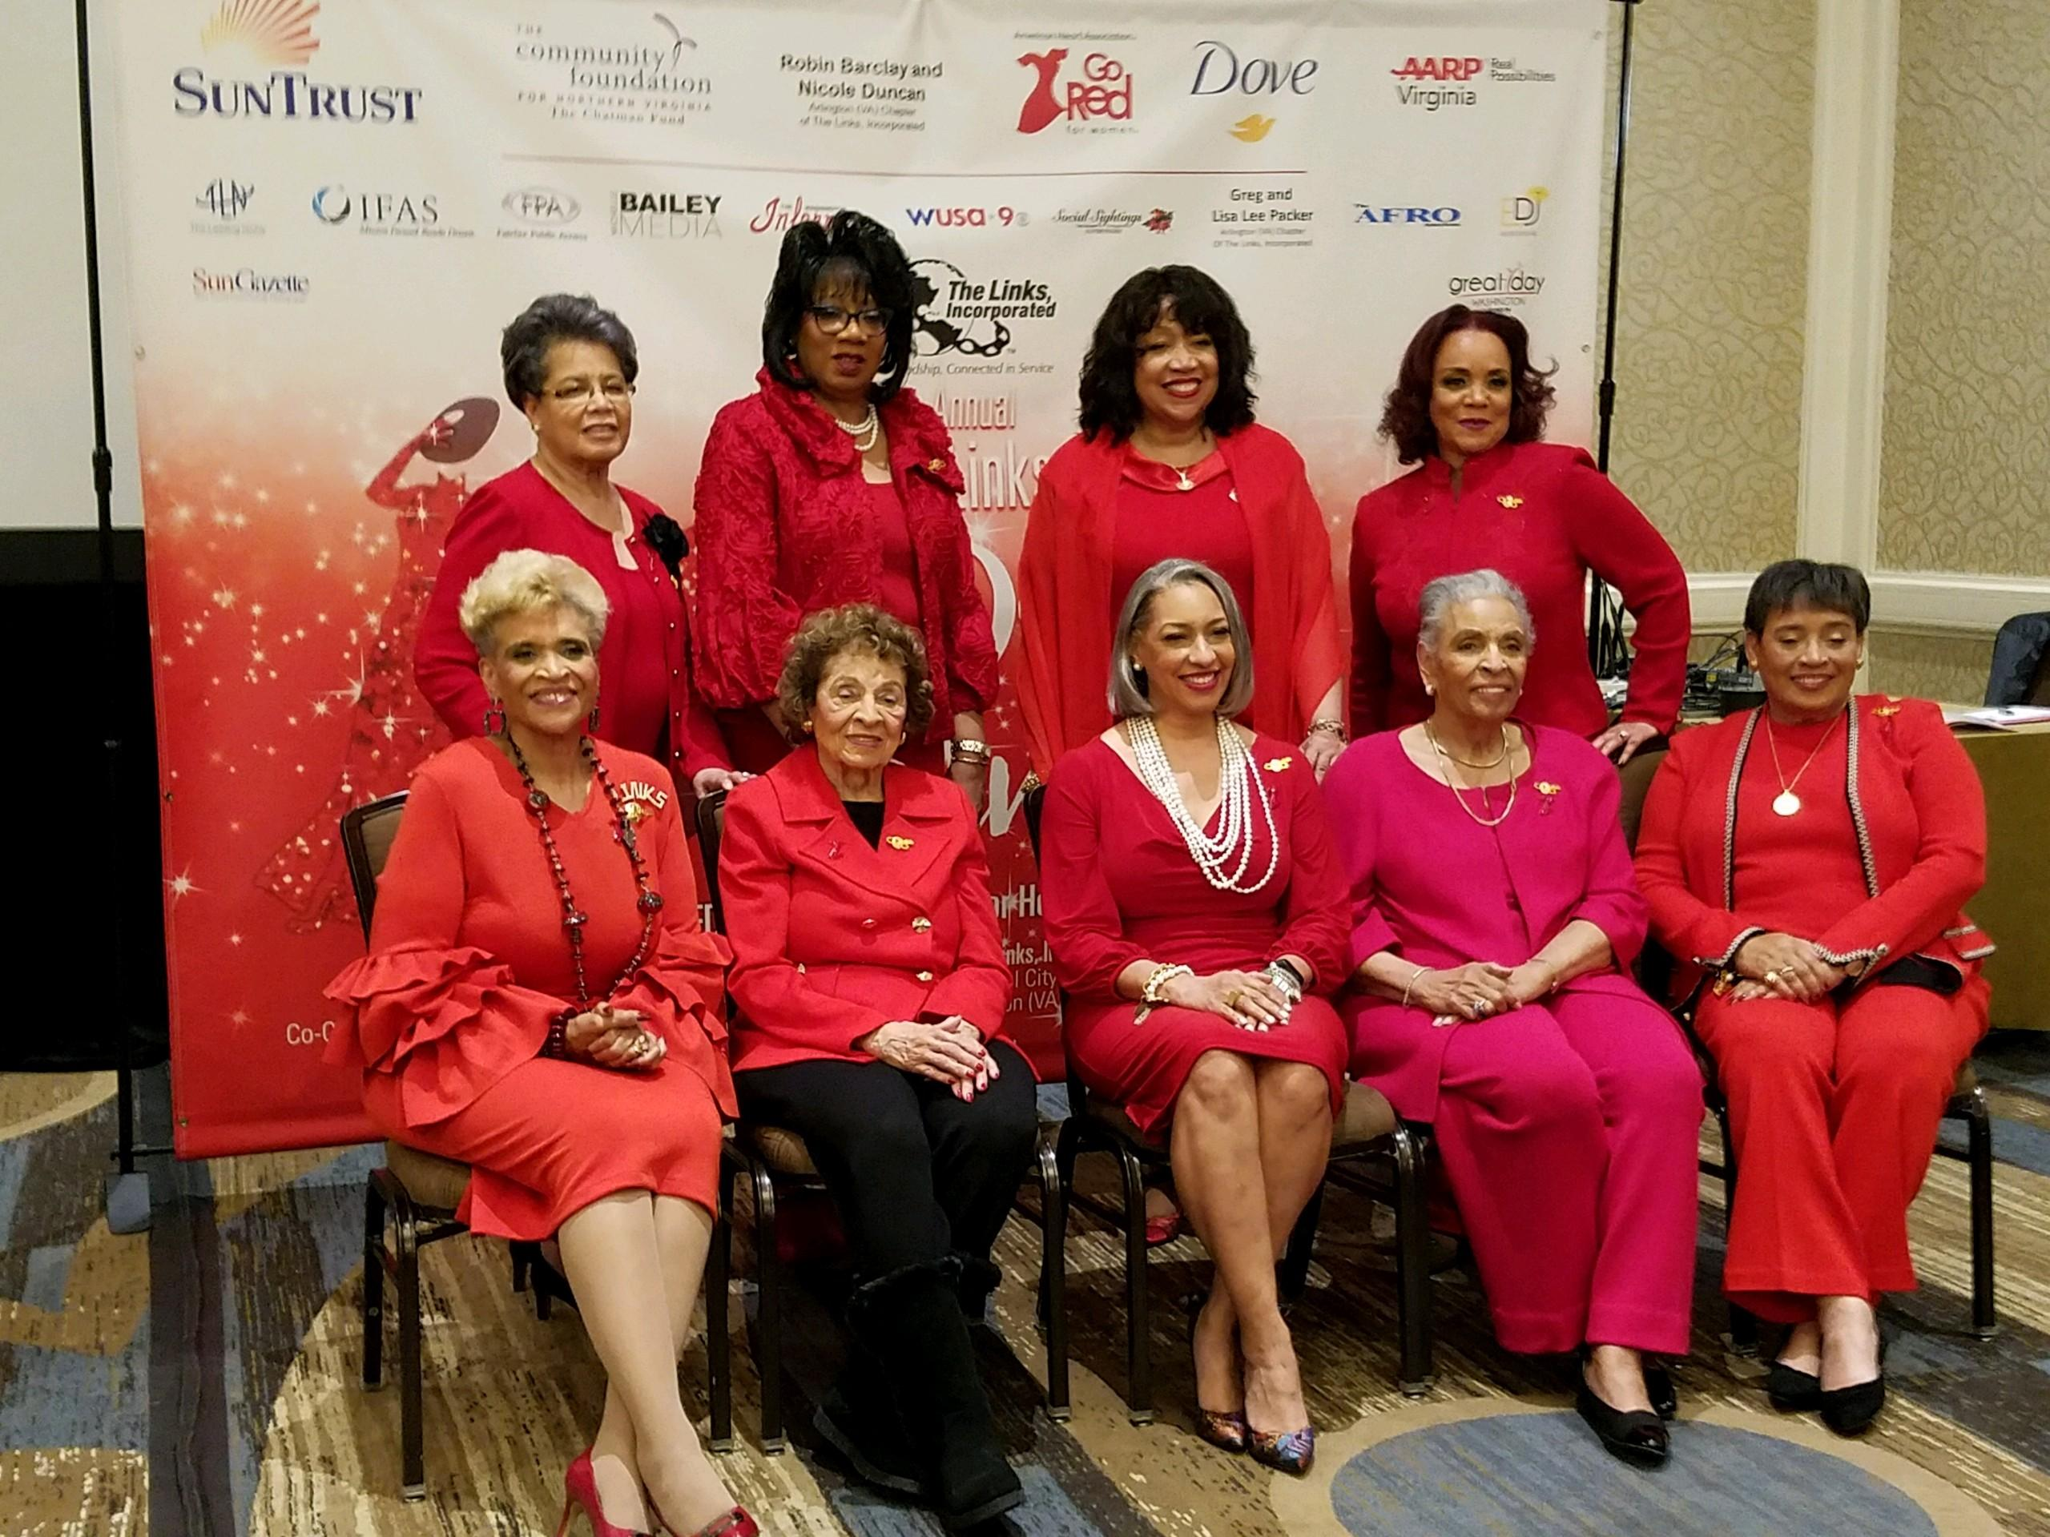
CA PRESIDENT’S CHAT

Slide 10

Happy Valentine’s Day
February 2019 Membership Updates
Candidate Approvals- New and Reinstatement
If you have not received final approval please notify Link Glenda ASAP
Completed by February 20th (Exception DOL’s/GDOL’s, voting cont. thru May 1)
February 1st Request for Platinum Status, now closed
March 1st /Chapter Mtg. written Request for Alumna Status
March 31st Written Leave of Absence request (LOA) 10% Membership
Next Vice Presidents Chat
Wednesday, February 13th @ 7pm CST
Membership Questions/Contact
Link Monica Allen, Area Vice-Director
linkmonicaallen@gmail.com
312.296.3508 mobile

Slide 11
RECOGNITION OF
25/40 YEAR MEMBERS
Central Area Conference will recognize 25 & 40 year members
Honoree’s Eligibility:
25 year members (inducted in 1993 or 1994)
40 year members (inducted in 1978 or 1979)
Chapter Vice Presidents to manage the process
1. Review the chapter membership records for eligible members
2. Complete one form per chapter, submit online to Central Area Website. If no members qualify, please indicate None on the form.
3. Provide Photo of each member that WILL be attending the conference (jpeg format)
.

Slide 12
25/40 Yr. Recognition cont.
Call to Conference registration form will include space to identify member as a 25 or 40 yr. member
If the awardee is not in attendance at the Area Conference, acknowledgements will be given to the Chapter President/Delegate to present at the next chapter meeting.
Submit completed form online to:
Centralarealinks.org no later than
Friday, March 1st
Questions?
Link Regena Glenn-Caldwell, Chair Rituals, Awards and Recognition linkregena@gmail.com Mobile 708.507.1795
Link Monica Allen linkmonicaallen@gmail.com 312.296.3508

Slide 13
Area Secretary Report
Adding Tools to the Toolkit Webinar for Secretaries (Recording and Corresponding) Feb. 11, 9 EST
Verify 1 in 5 Report. Indianapolis is in MMS, Report discrepancies for correction.

Slide 14
Area Secretary Report

Slide 15
Area Treasurers Report
Final deadline for chapter budgets approval for the next fiscal year (2019-20)
Some Chapters begin collecting dues as early as February. All fees and assessments are due prior to the collection and submission of dues.
The check for all dues and fees listed below are written to the chapter
Dues and Fees for current active members: The Links, Incorporated
DUES AND FEES
Dues for The Links, Incorporated | $195.00
Insurance Fee | $ 5.00
Total Dues an Fees per active member | $200.00
Dues and Fees for current active members: The Links Foundation, Incorporated
DUES AND FEES
Dues for The Links Foundation, Incorporated | $45.00
Grant-In-Aid | $40.00
Total Dues and Fees per Active Member | $85.00
Finance webinar – February 19, 2019 – 7pm (cst)

Slide 16

A donation of $1000 secures your membership in the Emerald Society.
$825 of your gift is tax deductible.
Emerald Society Members will enjoy exclusive privileges at the 2019 Central Area Conference including:
VIP Registration Area
VIP seating and entrance to all functions
VIP Reception
1 ticket to the White Rose Banquet
A Special Gift and more
Spaces are limited Link Sisters, act quickly to be sure you are included.
Payment Options: Donations can be in 1 payment of $1000, 2 equal payments of $500, or 4 equal payments of $250, a total of $1000 must be paid in full by March 1, 2019 through Eventbrite or by check via mail.
Send your check, made payable to The Links Foundation to:
Link Chalon Anderson
12716 Val Verde Dr.
Oklahoma City, OK 73142
email: chaloneanderson@gmail.com
Join Us!

Slide 17
Area Foundation Report
Director of Philanthropy and Fund Development Chair: Link Roz Hudnell, Western Area
Chapter Survey
  Include comments and concerns regarding the Foundation
Strategic Plan for The Links Foundation, Incorporated
Vision 2020 Endowment Campaign
  Total Funds Raised: $1,695,962
Link Tara Bradley
Central Area Representative
The Links Foundation, Incorporated
tbradley@ruthnap.com
405-209-4704

Slide 18
Nominating Committee February 2019
The National Nominating Committee |
For each area, the National Nominating Committee presented a National Candidates’ Information Call on January 10. The committee reviewed the specific guidelines relating to the Brochure rules, the new Photo Permission Form, Campaigning, Candidate Introduction Phone Calls, Candidates’ Speeches and the modified Call for Nominations Timeline. In each area, a Candidates’ Forum will take place and forum information is forthcoming. As the National President as informed the nation, major issues developed during some of the Area Call for Nominations. As you now know, one area’s complaints has been positively resolved and the committee patiently awaits the ruling relating to last formal complaint. To my knowledge, I am delighted to report that the Central Area Call for Nominations progressed without complaints. We thank God for the prevailing calmness in the Central Area.
Central Area Call for Nominations |
The Central Area Nominating Committee carefully reviewed the Candidates’ Brochures and Photo Forms and forwarded the documents to the National Nominating Chair in advance of the deadline. Candidates’ Brochures and Profiles should be posted on the National and Area websites by February 7. Presidents, I thank you in advance for encouraging your membership to also review the Brochures and Profiles and therefore direct your officer selection. As mentioned, the Central Area did not slate a Treasurer, however, a qualified Link will be identified at the Area Conference.
Chapter Call for Nominations | To chapters who are electing officers in 2019, I trust the Nominating Committee has filled the positions with qualified persons for the elected positions and the Nominating Committee. Thank you for your inquires and may you experience a smooth Call for Nomination.
In Friendship and Abiding Service,
Link Joyce | jacpss@aol.com | 708-474-0394
CA Nominating Committee Members: Cynthia Bryant-Welch, Memphis TN., Delta F. Jones-Walker, Northern IN.,Gale Jones Carson, River City, and Joyce A. Carter, Chair South Suburban Chicago (IL)

Slide 19
Program Pearls Call
2nd Monday of the Month
8pm (EST)
February 11, 2019
Call 712-775-7035 CODE 570841

Slide 20
Central Area, The Heart of Linkdom
is
Stepping to the Rhythm of Nashville
2000 Links walking 10,000 steps daily
=20,000,000 steps a day!
from January 1, 2019 until
Area Conference in Nashville
July 31, 2019

Slide 21


Slide 22


Slide 23
Central Area Photography Project
My Community Through the Eyes of the 21st Century African American Child Linking Images will become a book
All chapters are welcome to participate
Deadline for submitting photos is March 15, 2019
Monday’s Pearls Call will feature the Photography Project

Slide 24
Submission Guidelines
Each chapter may submit two photographs for the Photography Project to be included in the book.
Each photo must be identified per the Informational page.
All photographs should be high resolution digital electronic file with a resolution of 300 ppi in
JPG or TIF formats.
All entries should be emailed to centralareaart@gmail.com.
Deadline for submitting entries is March 15, 2019.
Questions can be directed to Link Schylbea Hopkins at sororhop@sbcglobal.net.
We look forward to the development of a beautiful book upon completion of this project which will be unveiled at the 2019 Central Area Conference.

Slide 25
ORGANIZATIONAL EFFECTIVENESS
ACTIVITY SCHEDULE
January 2019 – May 2019
Date/ Time | Activity | Comments
February 19, 2019 7:00pm – 8:30pm CST | Power of 1 Chat [WEBINAR] | O.E. Overview Establishing OE Committee Organizational Culture
February 28, 2019 7:00pm – 8:30pm CST | Power of 1 Chat [WEBINAR] | Situational Leadership Leadership Styles & Preference * In Preparation for Nominations & Elections
April 4, 2019 7:00pm – 8:30pm CST | Power of 1 Chat [WEBINAR] | Generational Differences Interpersonal Dynamics Team Building/ Teamwork Overcoming Dysfunctions
May 2, 2019 7:00pm – 8:30pm CST | Power of 1 Chat [WEBINAR] | Conflict Resolution I [Identifying & Understanding]
May 9, 2019 7:00pm – 8:30pm CST | Power of 1 Chat [WEBINAR] | Conflict Resolution II [Reacting vs. Responding]
May 23, 2019 7:00pm – 8:30pm CST | Power of 1 Chat [WEBINAR] | The H.E.A.R.T. of Communication

Slide 26
CA PRESIDENT’S CHAT
Questions and Answers

