Slide 1
Candidates for Membership
October 2023

Slide 2
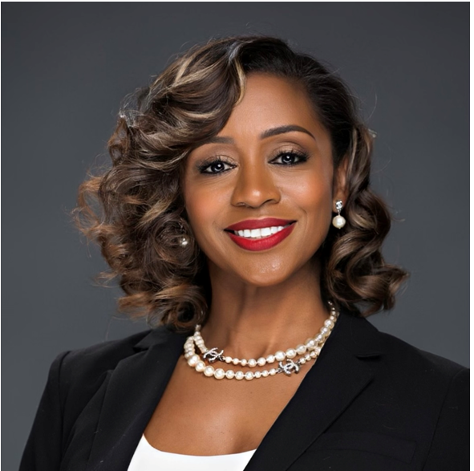
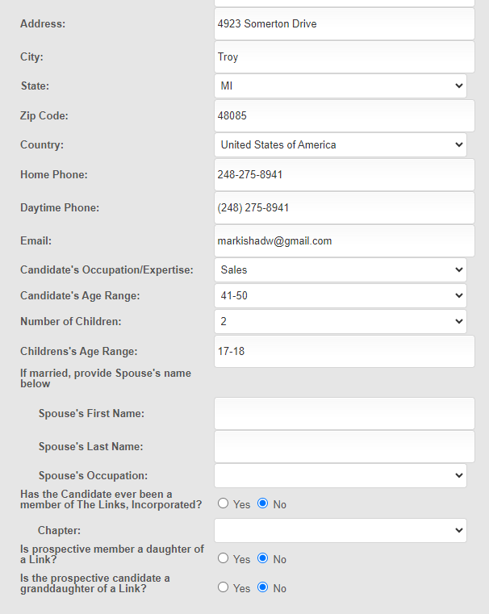
Candidate Name: Markisha Williams (Daughter of Connecting Link, Mark Williams)
Sponsor: Link Kimberly Keaton Willliams (Bonus Mom)

Slide 3
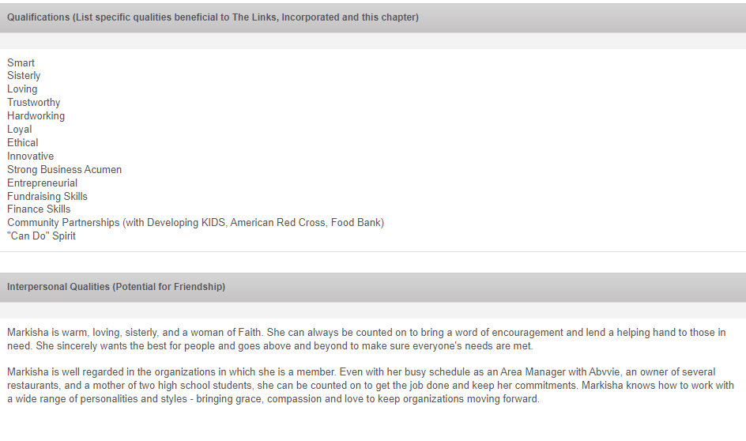
Candidate Name: Markisha Williams (Daughter of Connecting Link, Mark Williams)
Sponsor: Link Kimberly Keaton Willliams (Bonus Mom)
Markisha is a dynamic woman who has a heart of gold. Her intelligence and business acumen are equally matched with a genuine spirit of sisterhood and loyalty.
Markisha has a bachelor’s degree in Healthcare Administration and a Masters of Business Administration. With that strong education foundation, she excels as an Area Manager for Abbvie, a Bio Pharma company. Additionally, she is a successful co-owner of several restaurants in the Detroit metro area.
In addition to her professional passions, Markisha has served as treasurer for Alpha Kappa Alpha Sorority, Chi Epsilon Omega Chapter, Fundraising Chair for Jack and Jill, Oakland County (JJOC), and currently serves as Foundation Chair of JJOC. Her entrepreneurial spirit, financial skills, fundraising skills, and heart for service would be an asset to our chapter.

Slide 4
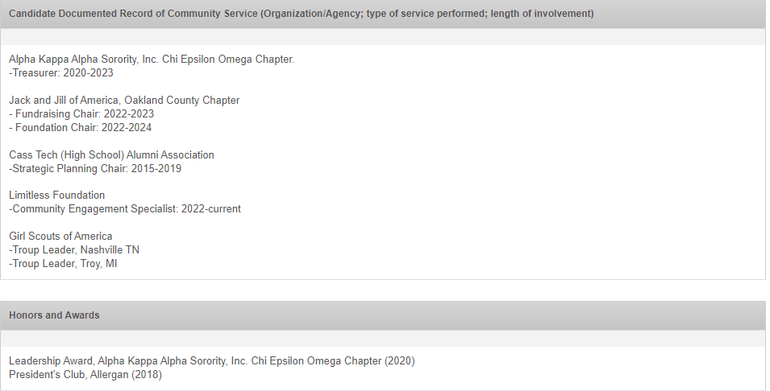
Candidate Name: Markisha Williams (Daughter of Connecting Link, Mark Williams)
Sponsor: Link Kimberly Keaton Willliams (Bonus Mom)

Slide 5
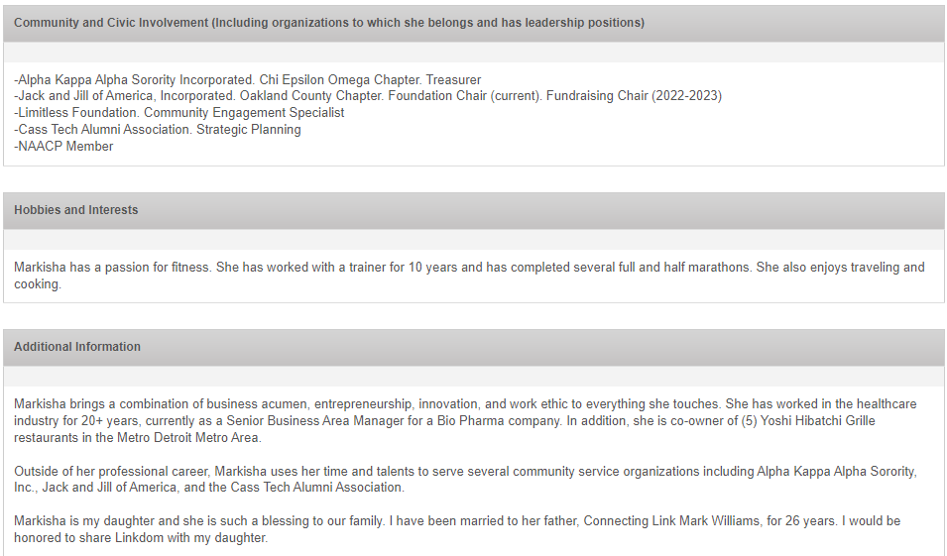
Candidate Name: Markisha Williams (Daughter of Connecting Link, Mark Williams)
Sponsor: Link Kimberly Keaton Willliams (Bonus Mom)
Markisha and I officially became family on October 11, 1997 when I married her father, Connecting Link Mark Williams. She is a my “bonus” daughter in every sense of the word and I would be honored to share Linkdom with Markisha.

Slide 6
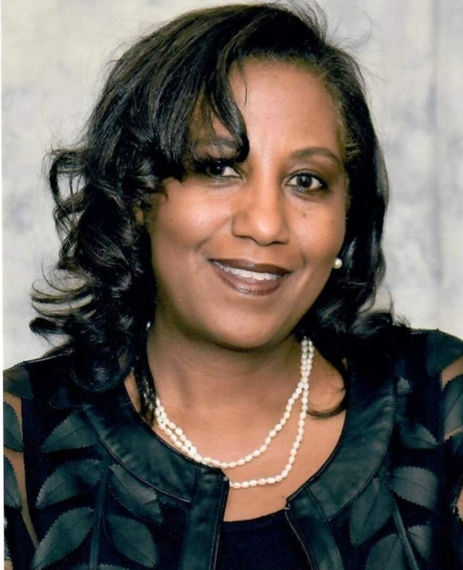
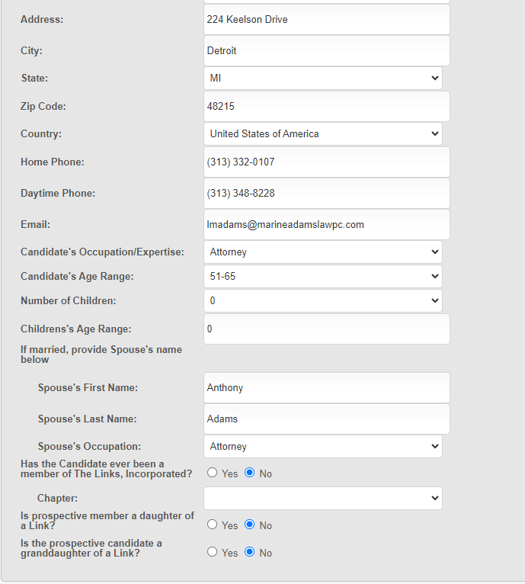
Candidate Name: Lynn Marine Adams
Sponsor: Mearon Lewers

Slide 7
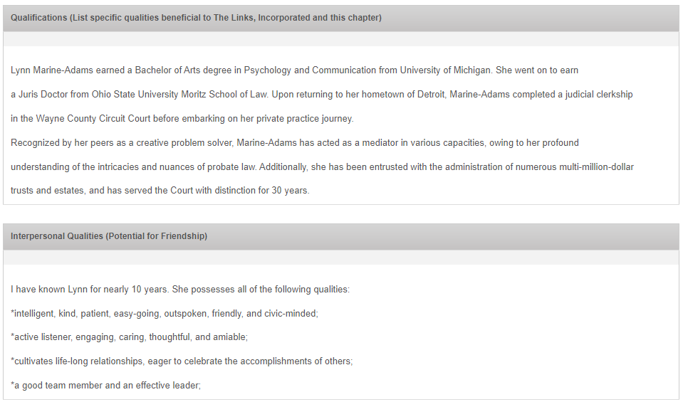
Candidate Name: Lynn Marine Adams
Sponsor: Mearon Lewers

Slide 8
Candidate Name: Lynn Marine Adams
Sponsor: Mearon Lewers

Slide 9
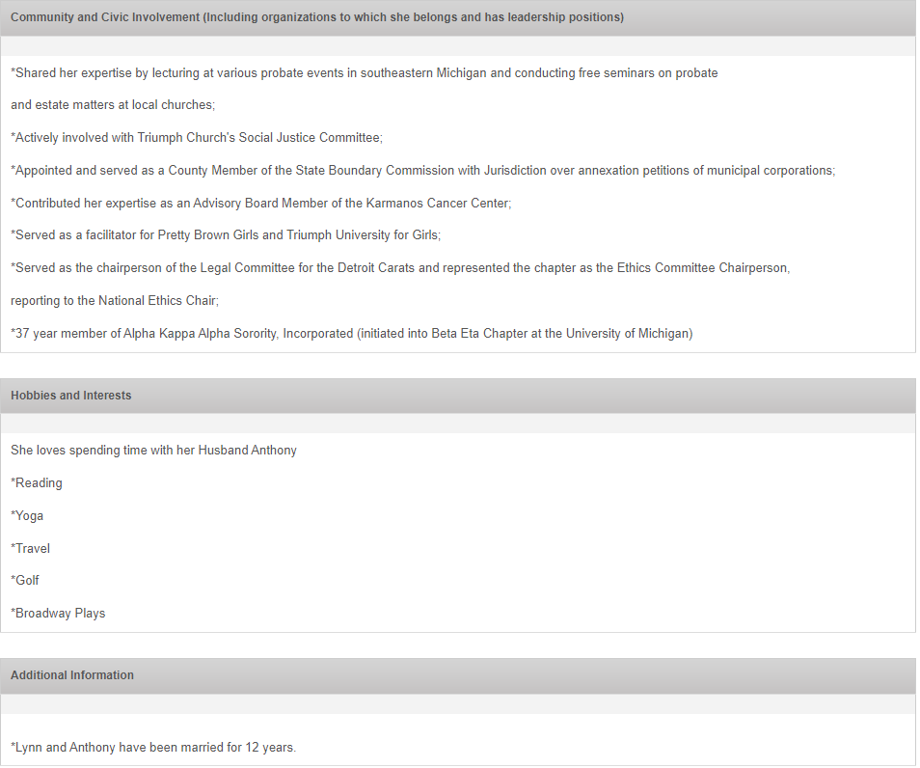
Candidate Name: Lynn Marine Adams
Sponsor: Mearon Lewers

Slide 10
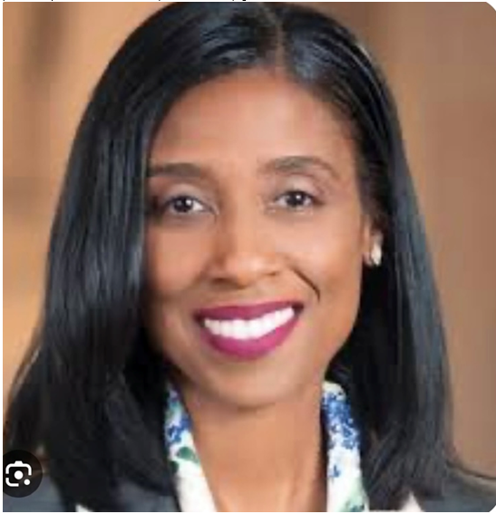
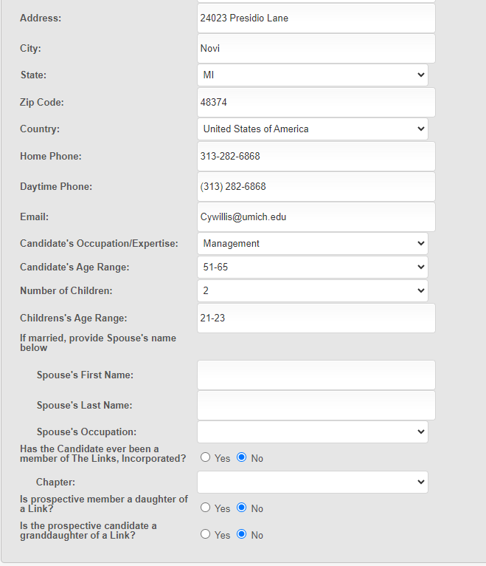
Candidate Name: Cassandra Willis-Abner
Sponsor: Link Marlo Johnson Roebuck

Slide 11
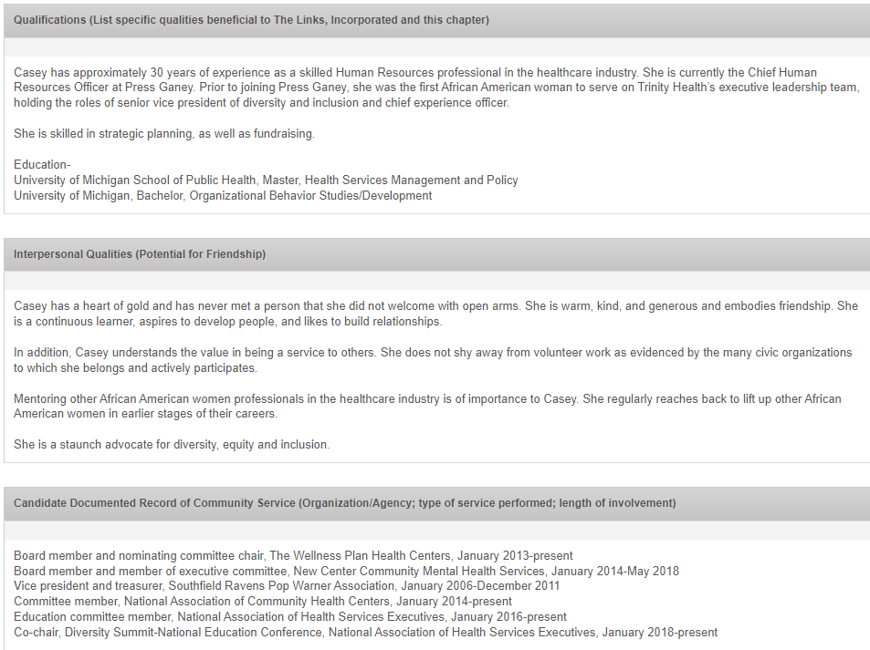
Candidate Name: Cassandra Willis-Abner
Sponsor: Link Marlo Johnson Roebuck

Slide 12
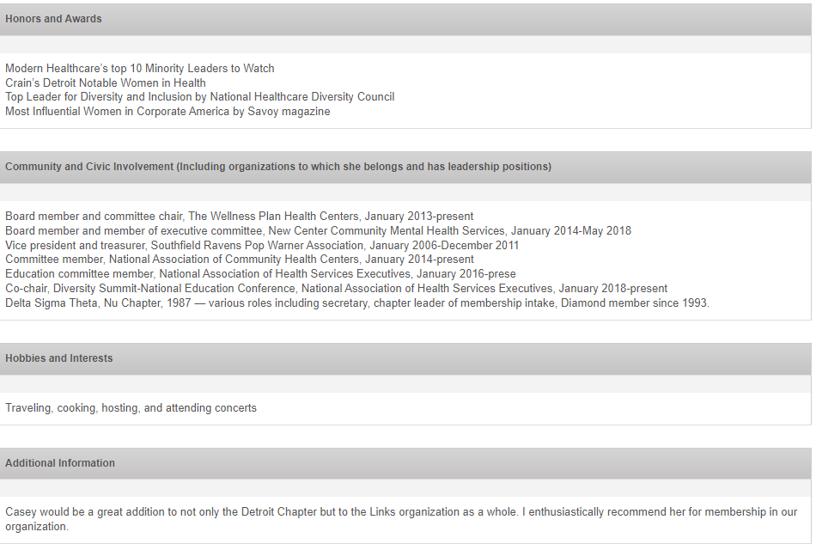
Candidate Name: Cassandra Willis-Abner
Sponsor: Link Marlo Johnson Roebuck

Slide 13
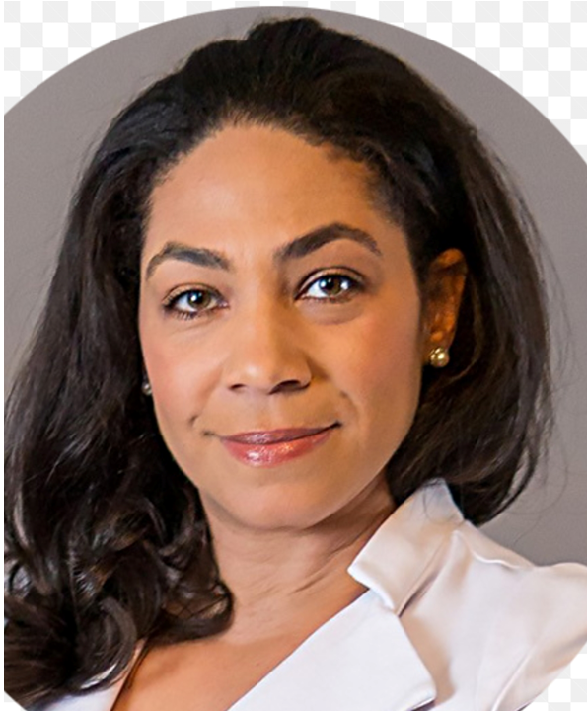
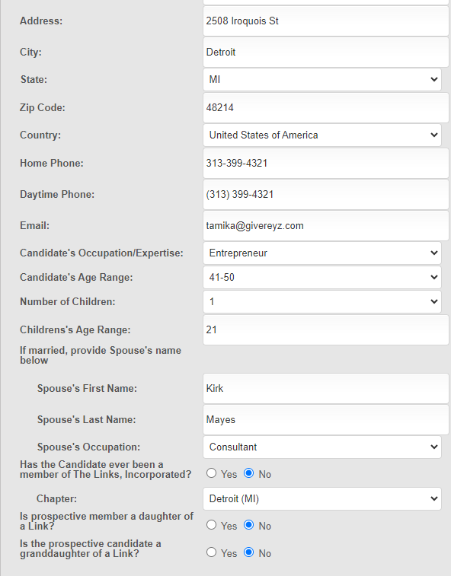
Candidate Name: Tamika Mayes
Sponsor: Link Anika Goss-Foster

Slide 14
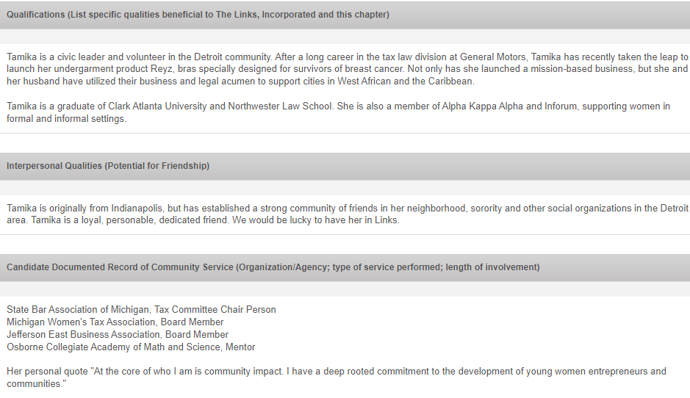
Candidate Name: Tamika Mayes
Sponsor: Link Anika Goss-Foster

Slide 15
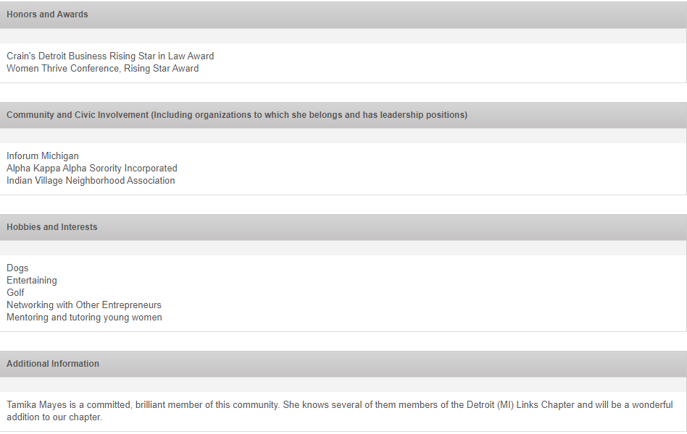
Candidate Name: Tamika Mayes
Sponsor: Link Anika Goss-Foster

Slide 16
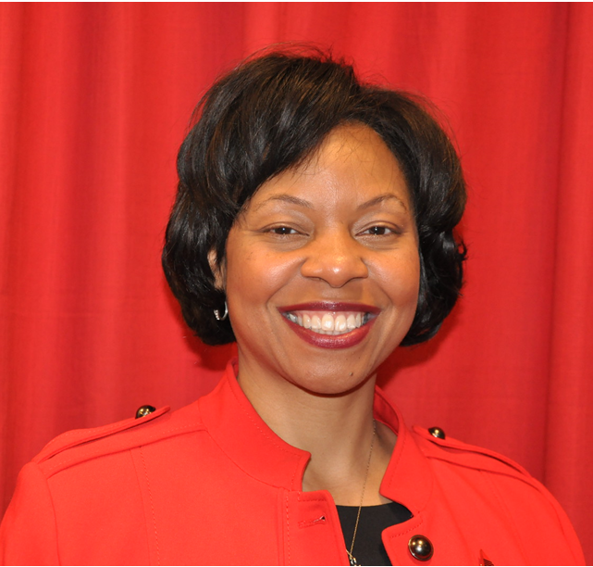
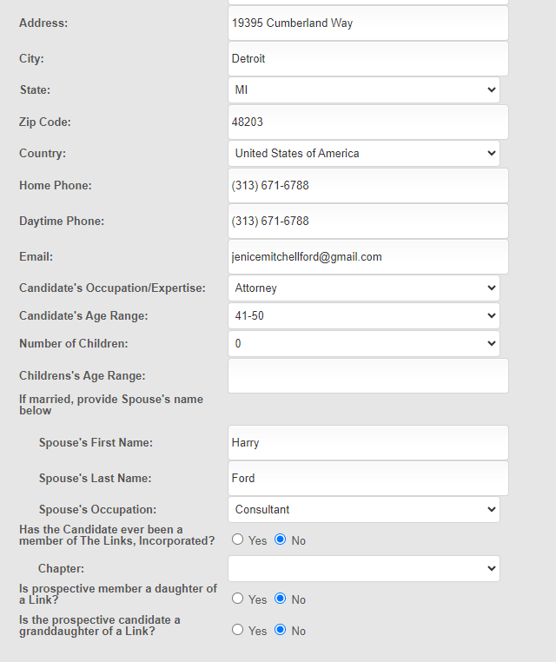
Candidate Name: Jenice Mitchell Ford
Sponsor: Link Chrystal Wilson

Slide 17
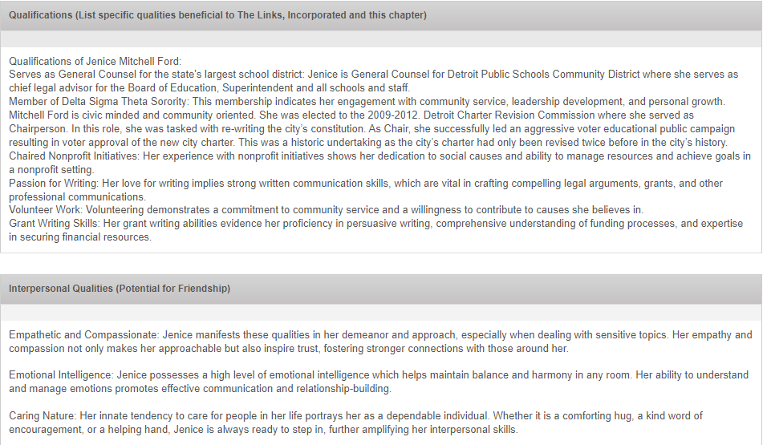
Candidate Name: Jenice Mitchell Ford
Sponsor: Link Chrystal Wilson

Slide 18
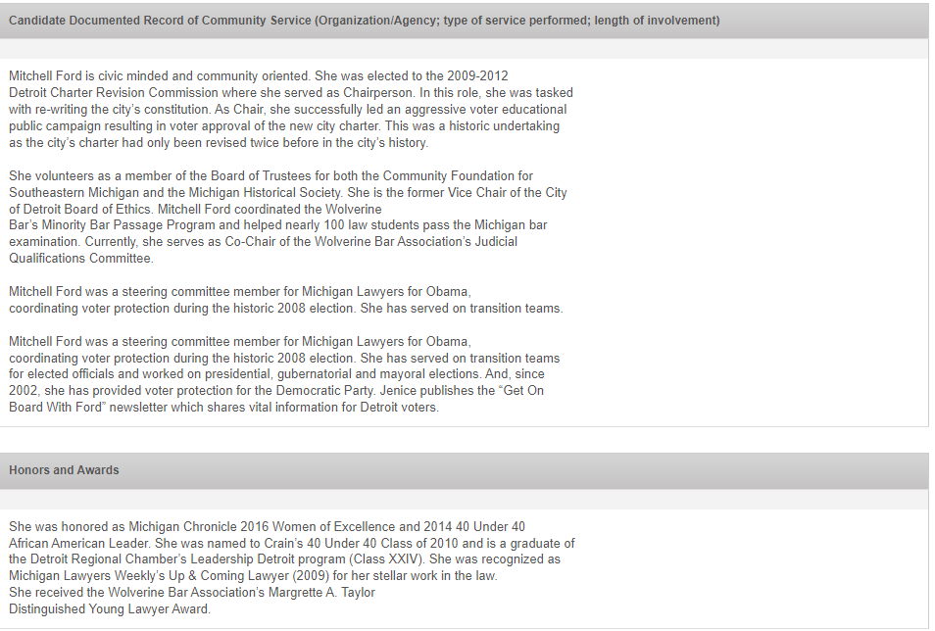
Candidate Name: Jenice Mitchell Ford
Sponsor: Link Chrystal Wilson

Slide 19
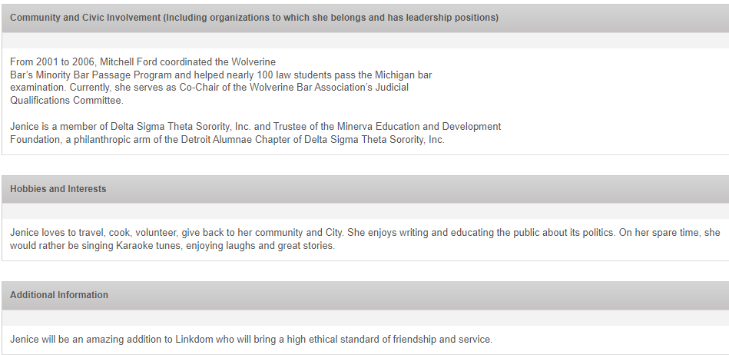
Candidate Name: Jenice Mitchell Ford
Sponsor: Link Chrystal Wilson

Slide 20
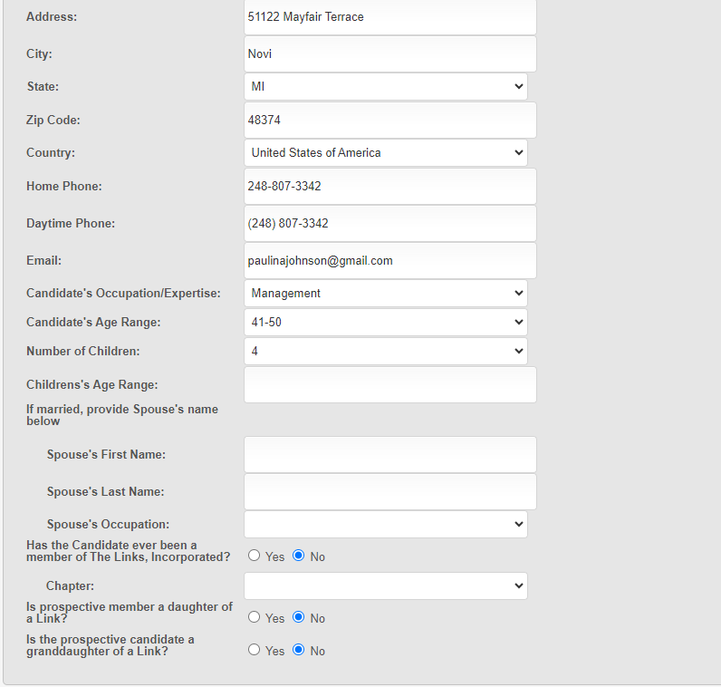
Candidate Name: Paulina Johnson
Sponsor: Link Corri Lynn Wofford

Slide 21
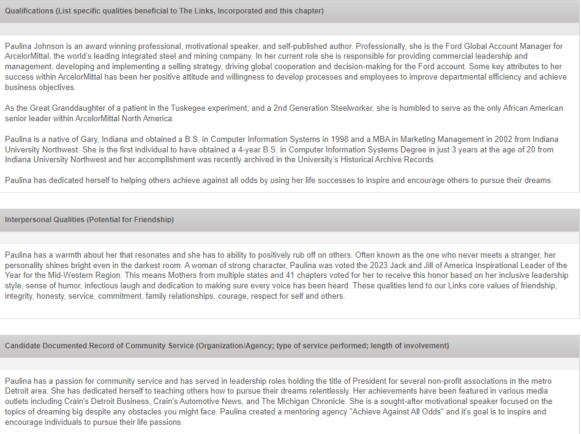
Candidate Name: Paulina Johnson
Sponsor: Link Corri Lynn Wofford

Slide 22
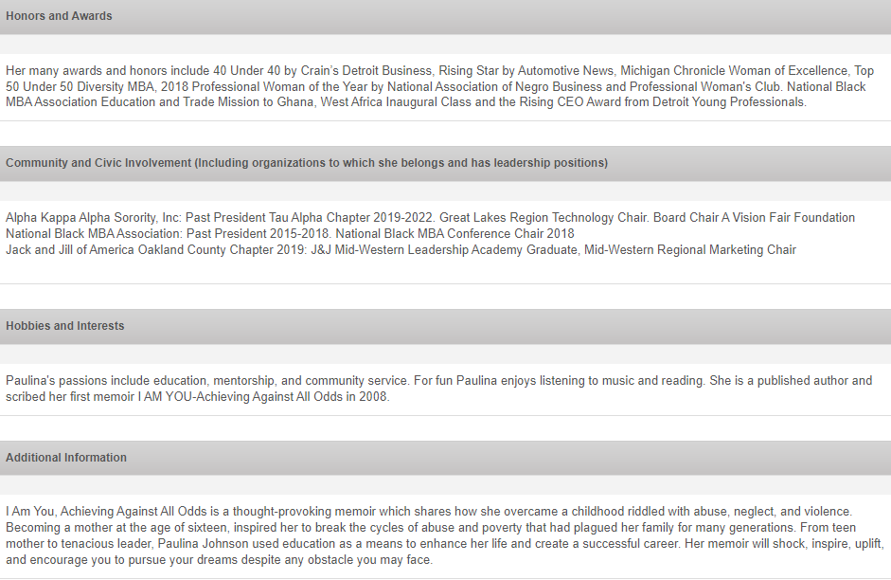
Candidate Name: Paulina Johnson
Sponsor: Link Corri Lynn Wofford

Slide 23
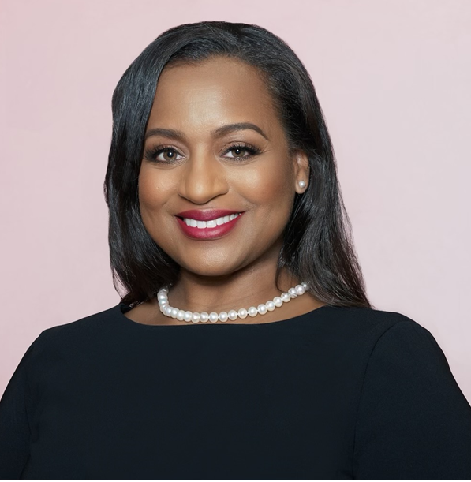
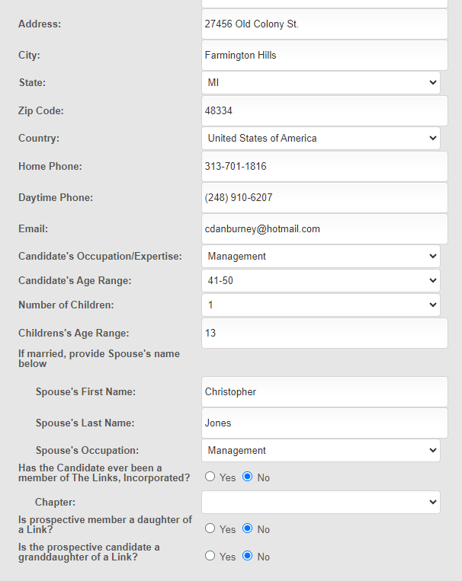
Candidate Name: Carla Burney-Jones
Sponsor: Link Judith McNeeley

Slide 24
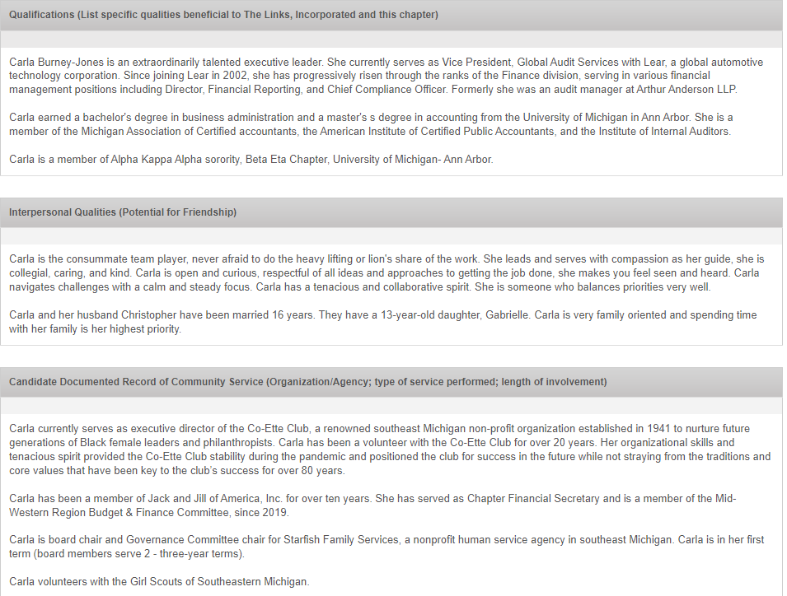
Candidate Name: Carla Burney-Jones
Sponsor: Link Judith McNeeley

Slide 25
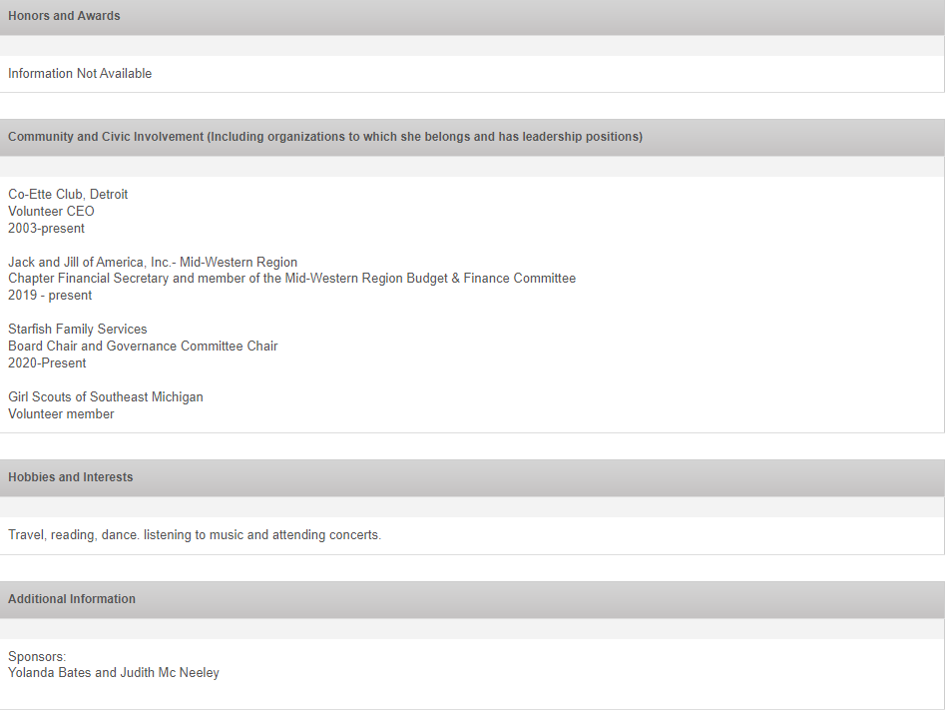
Candidate Name: Carla Burney-Jones
Sponsor: Link Judith McNeeley

Slide 26
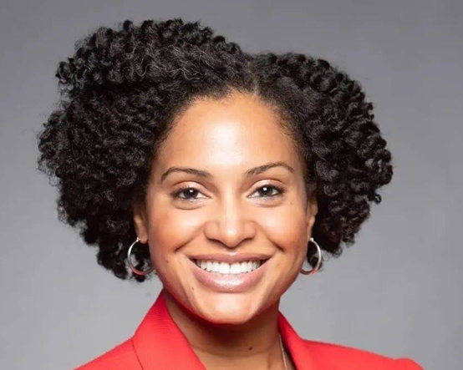
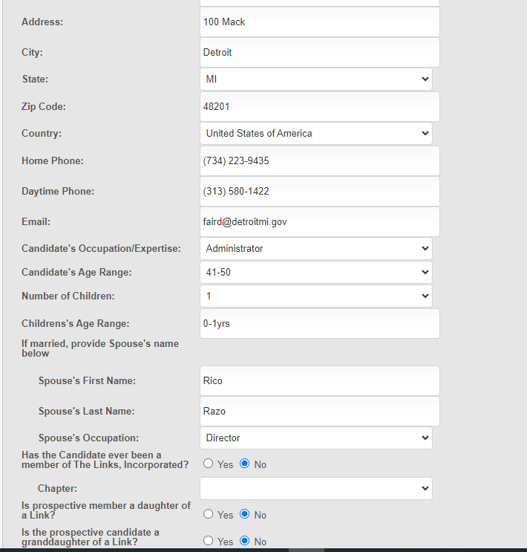
Candidate Name: Denise Fair Razo
Sponsor: Link Iris Taylor

Slide 27
Candidate Name: Denise Fair Razo
Sponsor: Link Iris Taylor

Slide 28
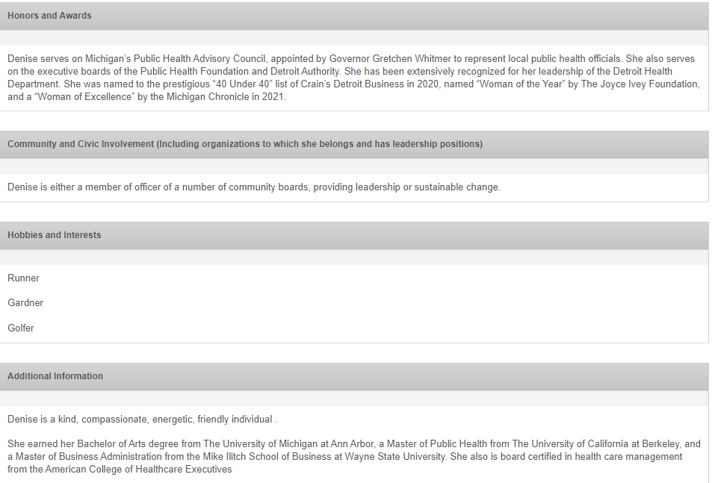
Candidate Name: Denise Fair Razo
Sponsor: Link Iris Taylor

Slide 29
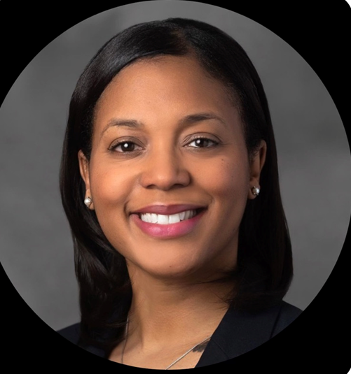
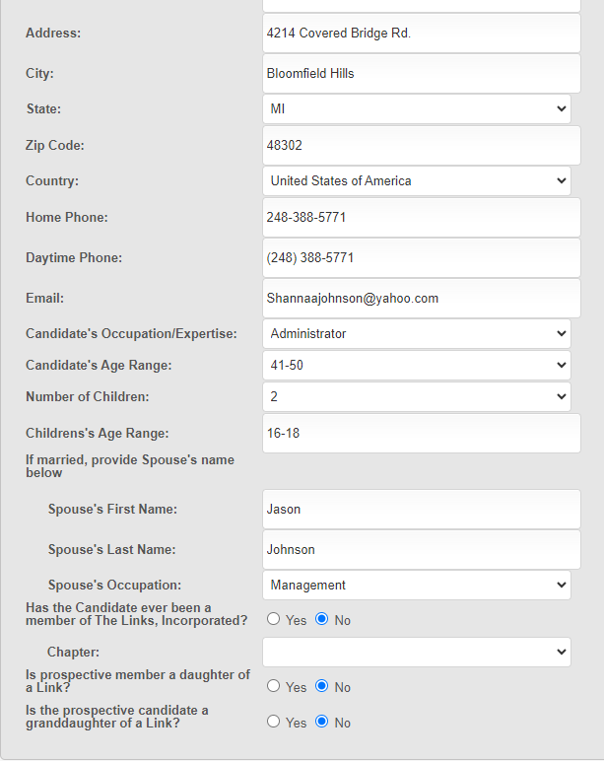
Candidate Name: Shanna Johnson
Sponsor: Link Denise Brooks Williams

Slide 30
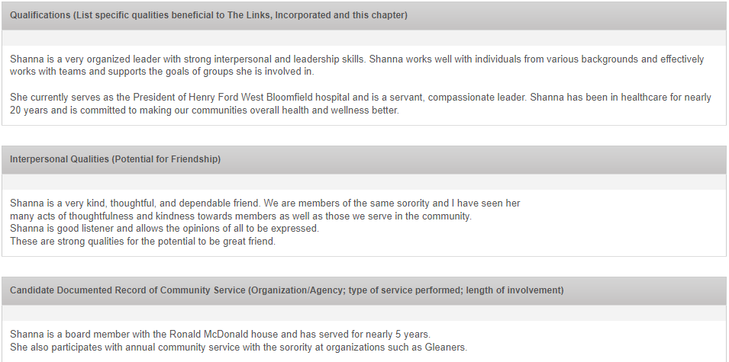
Candidate Name: Shanna Johnson
Sponsor: Link Denise Brooks Williams

Slide 31
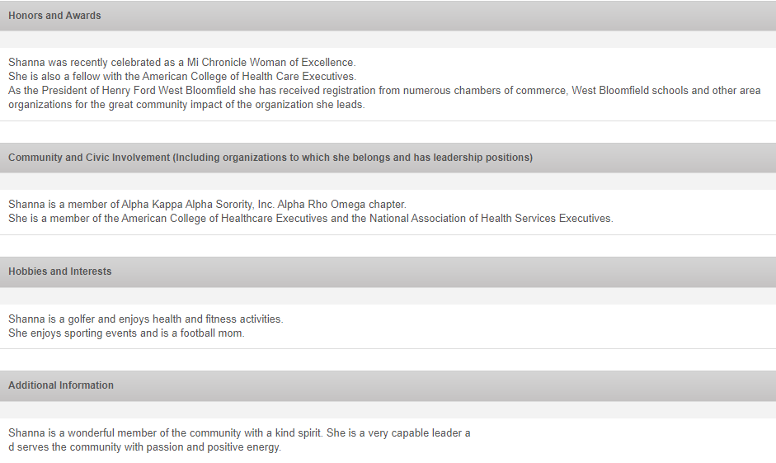
Candidate Name: Shanna Johnson
Sponsor: Link Denise Brooks Williams

Slide 32
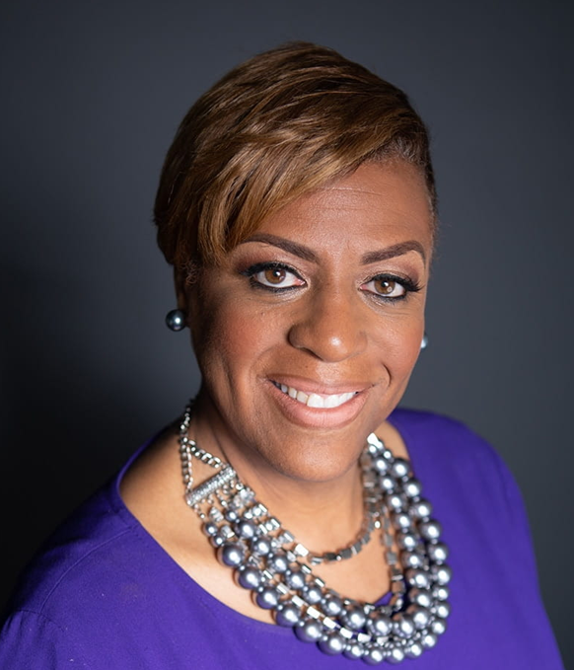
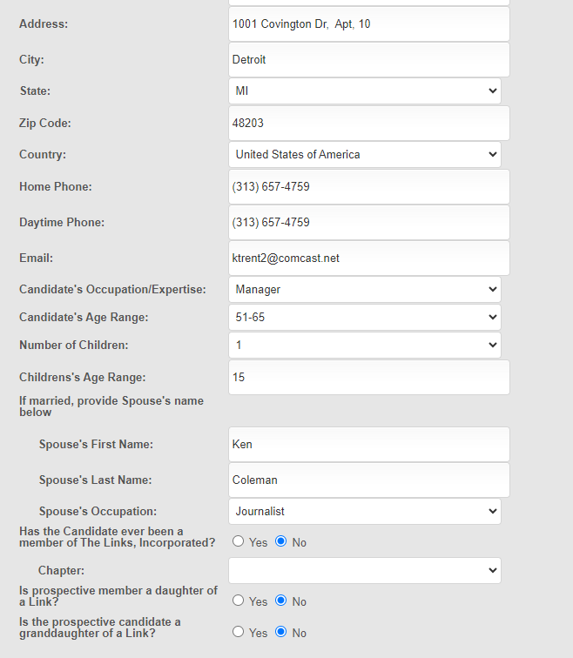
Candidate Name: Kimberly Trent
Sponsor: Link Portia Roberson

Slide 33
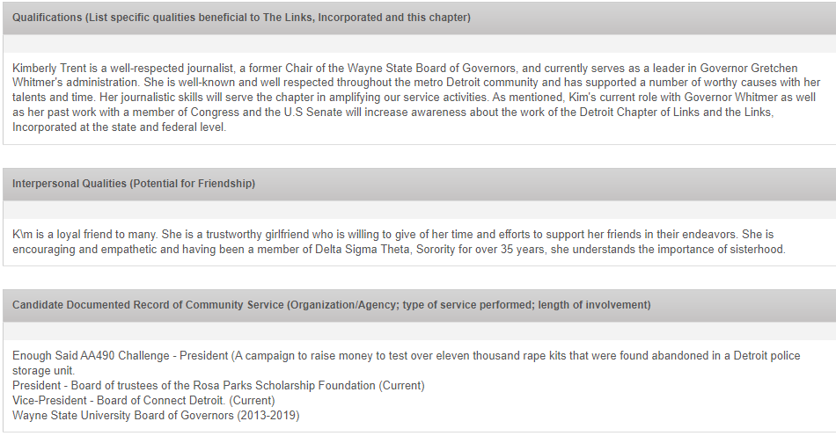
Candidate Name: Kimberly Trent
Sponsor: Link Portia Roberson

Slide 34
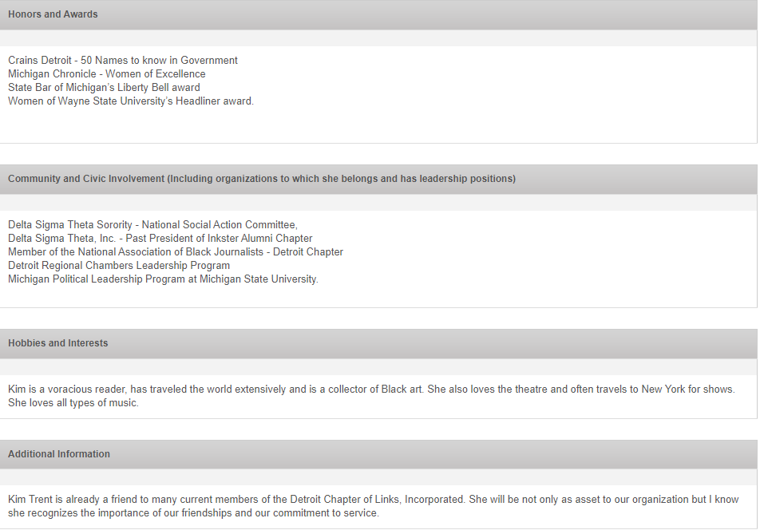
Candidate Name: Kimberly Trent
Sponsor: Link Portia Roberson

Slide 35
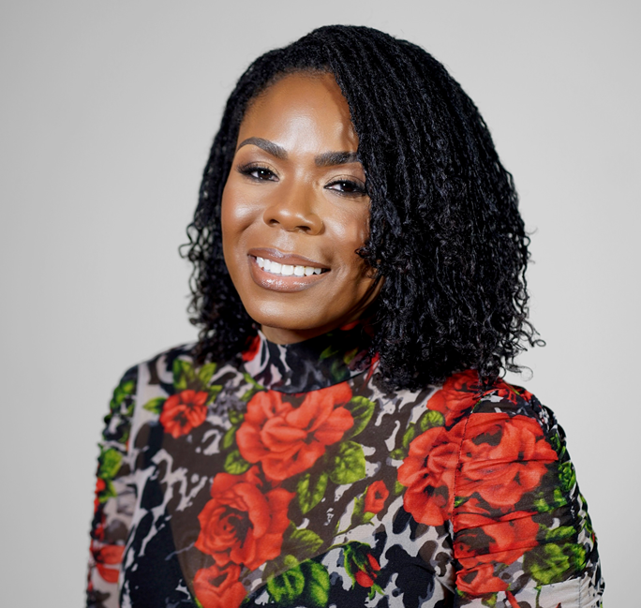
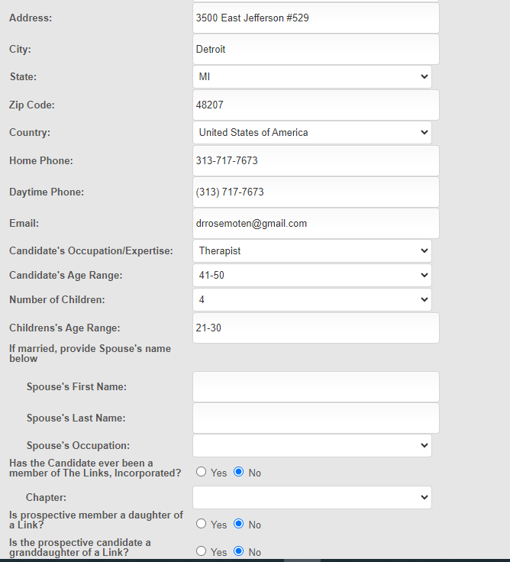
Candidate Name: Dr. Rose Moten
Sponsor: Link Gail Perry-Mason

Slide 36
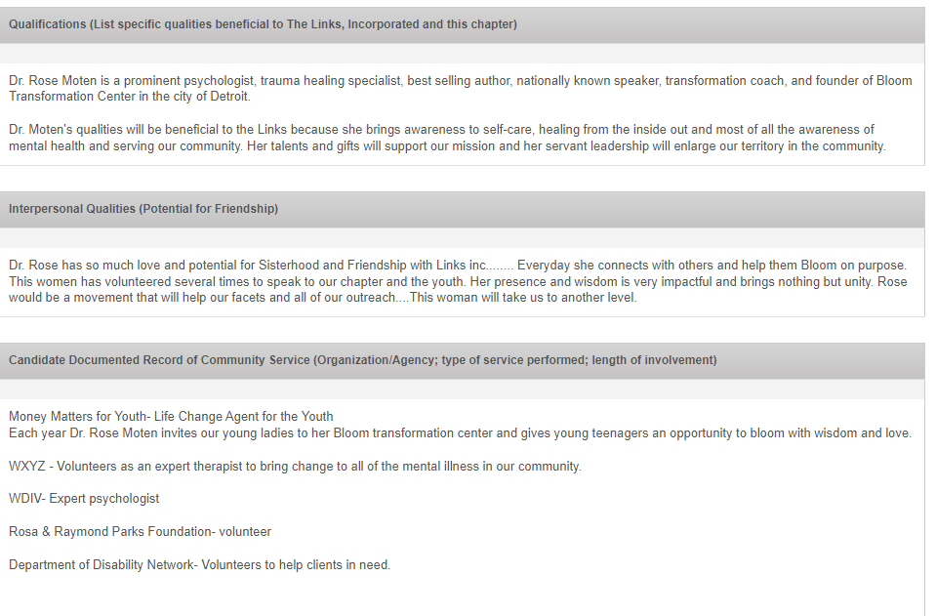
Candidate Name: Dr. Rose Moten
Sponsor: Link Gail Perry-Mason

Slide 37
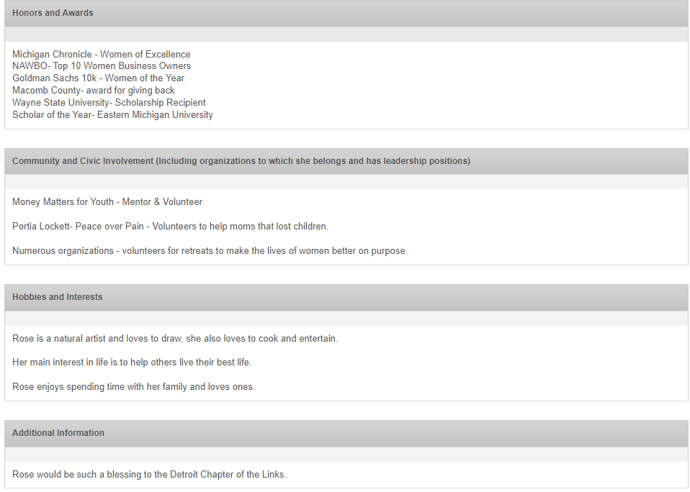
Candidate Name: Dr. Rose Moten
Sponsor: Link Gail Perry-Mason

Slide 38
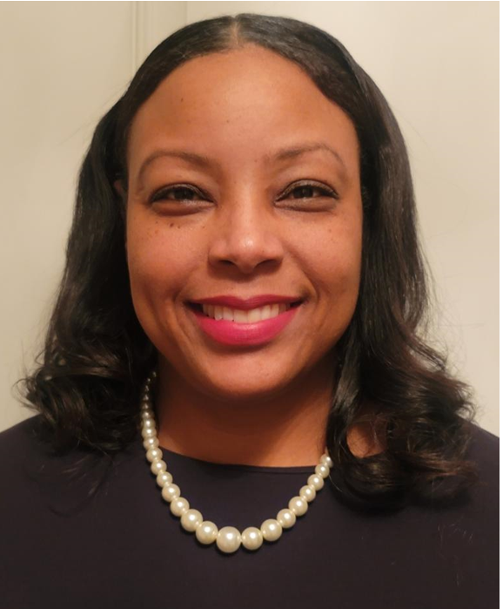
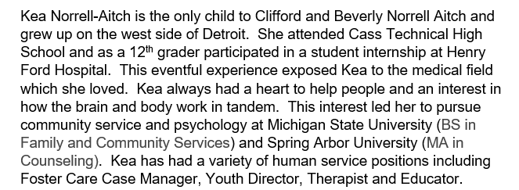
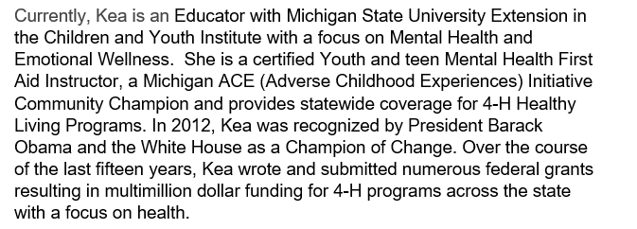
Candidate Name: Kea Norrell-Aitch (Daughter of Link Beverly Norrell-Aitch)
Sponsor: Link Charmaine Johnson

Slide 39
Candidate Name: Kea Norrell-Aitch (Daughter of Link Beverly Norrell-Aitch)
Sponsor: Link Charmaine Johnson

Slide 40
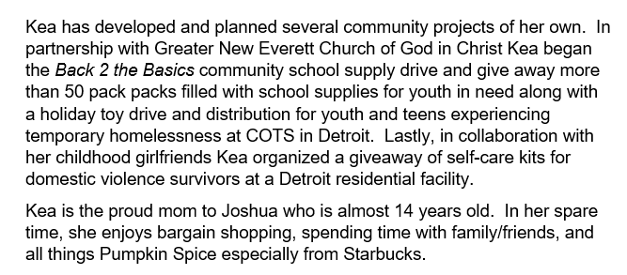
Candidate Name: Kea Norrell-Aitch (Daughter of Link Beverly Norrell-Aitch)
Sponsor: Link Charmaine Johnson

