Slide 1
TREASURER’S MONTHLY REPORT – UNRESTRICTED AND RESTRICTED ACCOUNTS Detroit (MI) Chapter of The Links, Incorporated SEPTEMBER MONTHLY FINANCIAL REPORT 2023
Link Tyra Evans
Detroit (MI) Links Chapter Inc.

Slide 2
Unrestricted Chase Banking Account
OPERATIONS CHECKING ACCOUNTING
Balance Forward, Sept 1, 2023, Income $14,543.35
Deposit/Credits via Paypal – $1,781.24
Total Income and Interest $0.00
Total Brought Forward, Income and Interest $ 16,324.59

Slide 3
September Deposits/Expenses
Unrestricted (Ops) Chase Banking Expenses

Slide 4
BALANCE $LESS: Bank Charges $0
Expenses/Checks incl. PayPal – $3,500.20
Bank Balance – Sept 30, 2023, $12,824.39
Unrestricted Chase Banking Account

Slide 5
Restricted Chase Banking Account
RESTRICTED MONTHLY FINANCIAL REPORT
Balance Forward, Sept 1, 2023 Income $30,740.39

Slide 6
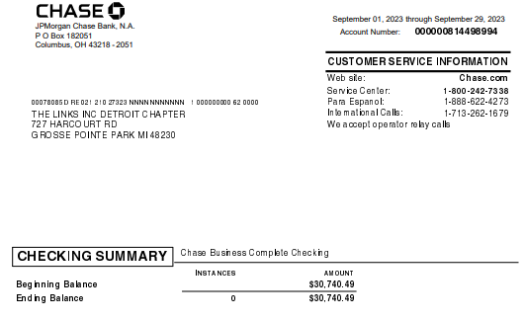
September Expenses
Restricted Chase Banking Expenses

Slide 7
LESS: Bank Charges $0.00
Bank Balance – September 30, 2023
$30,740.49
Restricted Chase account

Slide 8
Upcoming Financial Obligations
September 15th, 2023 DEADLINE
990 Due- Completed
Bonding Paid- Completed
IRS Filing Due- Completed
Internal Audit Certification Due- Completed

Slide 9
National Finance Team’s Priorities
The following 7 workshops will be delivered by the National Finance Team
Overview, Transition and Financial Deliverables –August 22, 2023- COMPLETED
Budgeting and Fundraising –October 2023
QuickBooks I and II –November 2023
Electronic Voucher with Approval Process and Online Payment Processing -January 2024
Financial Deliverables Review –February 2024
Workshop on Dues Processing and Transitioning –March 2024
Finance 101, Transition and Financial Deliverables –June 2024 National Assembly

