Slide 1

TREASURER’S MONTHLY REPORT – UNRESTRICTED AND RESTRICTED ACCOUNTS
Detroit (MI) Chapter of The Links, Incorporated
FEBRUARY MONTHLY FINANCIAL REPORT 2024
Link Tyra Evans
Detroit (MI) Links Chapter Inc.

Slide 2



DETROIT CHAPTER HAS ZELLE!!!!!
Detroitlinkszelle@gmail.com

Slide 3
Unrestricted Chase Banking Account
OPERATIONS CHECKING ACCOUNTING
Balance Forward, February 1, 2024, Income $12,644.01
Deposit/Credits via Paypal/Zelle – $8,090.48
Total Income and Interest $0.00
Total Brought Forward, Income and Interest $ 20,734.49

Slide 4
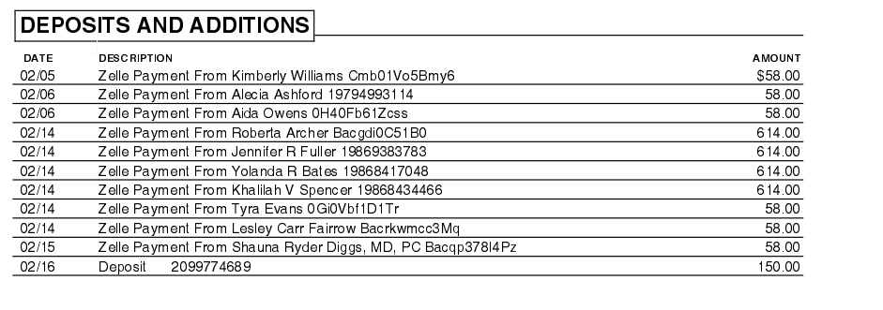
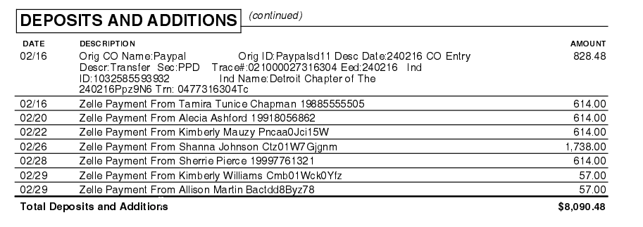
February Deposits
Unrestricted (Ops) Chase Banking Expenses

Slide 5
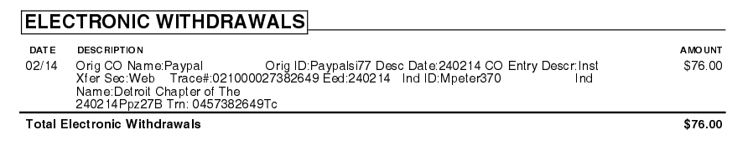
February Expenses
Unrestricted (Ops) Chase Banking Expenses

Slide 6
BALANCE $LESS:Bank Charges $23,128.37
Expenses/Checks incl. PayPal/Zelle – $76.00
Bank Balance – January 31, 2024 $20,658.49
Unrestricted Chase Banking Account

Slide 7
Restricted Chase Banking Account
RESTRICTED MONTHLY FINANCIAL REPORT
Balance Forward, February 1, 2024 Income $32,043.08

Slide 8
February Deposits
Restricted Chase Banking Deposits
t

Slide 9
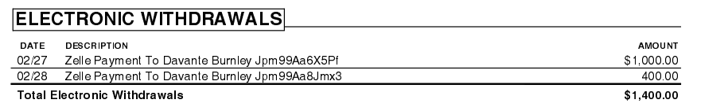
February Expenses
Restricted Chase Banking Expenses
HHS- food for BWFE

Slide 10
LESS: Bank Charges $0.00
Balance Brought Forward:$32,043.08
Bank Balance – February 29th, 2024 $30,643.08
Expenses/Checks incl. PayPal/Zelle: $76.00
Restricted Chase account

Slide 11

Upcoming Financial Obligations
March 15-Chapter unrestricted and restricted budgets are due to Area Treasurer
Completed
• April 1 @ 11:59 pm EST Dues are due
• May 1 @ 11:59 pm EST
Dues are due with a $25.00 late fee, each, for The Links, Incorporated and The Links Foundation
May 2 -Any individual with unpaid dues are no longer a member of the organization.

Slide 12
National Finance Team’s Priorities
The following 7 workshops will be delivered by the National Finance Team
Overview, Transition and Financial Deliverables –August 22, 2023- COMPLETED
Budgeting and Fundraising –October 2023 COMPLETED
QuickBooks I and II –November 2023 1 COMPLETED
Electronic Voucher with Approval Process and Online- COMPLETED
Financial Deliverables Review –February 2024 COMPLETED
Workshop on Dues Processing and Transitioning –March 2024
Finance 101, Transition and Financial Deliverables –June 2024 National Assembly

Slide 13


