Slide 1
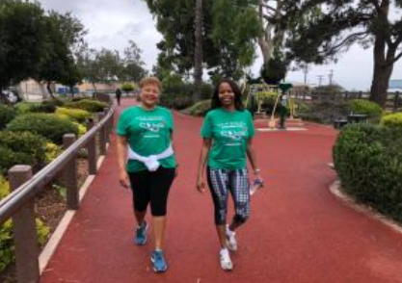
Detroit Links, Inc. New Member Mentoring Guideline Suggestions for a good Mentor/Mentee Connection Will You Help Continue the Legacy? Please Consider Being a Mentor!
“We are our sisters’
keepers!
We have a responsibility to build one another up, impart wisdom and share our lessons learned.
Mentoring is a mutually beneficial relationship that exemplifies friendship and service which are the cornerstones of our great organization.”
Glenda Masingale Manson
19th Central Area Director
Ten wonderful ladies are joining our friendship circle, we need you!!
Here’s How to Help—Let’s Get Into It:

Slide 2
Why Be A Mentor?
Encourage dynamic engagement
Effective onboarding of new, transfer or reinstated Links
Smooth Introduction to Chapter and organizational culture and traditions
Retain Knowledge and Chapter history
Leadership development
Address long-term organizational needs at the Chapter, Area, and National levels
Facilitate open communications
Provide guidance throughout relationship
Make a new friend!

Slide 3
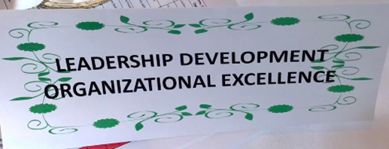
Considerations for Becoming a Mentor – Is This YOU?
Be a Chapter member for at least two years
Have attended at least one Area Conference or one National Assembly in the past five years
Be an active member of a facet and an operational committee
Possess an open, friendly personality and excellent interpersonal skills, have a solid knowledge base about Linkdom including the Constitution and Bylaws, Manual of Procedures, and Chapter history and Culture
Display a teaching and cooperative spirit
Be able to provide guidance and constructive feedback
Be willing to engage and have available time for the mentee and structured activities
Suggestions:
Mentors and mentees are encouraged to attend at least two meetings and activities together per year
Ensure any information shared that is confidential is indicated as such

Slide 4
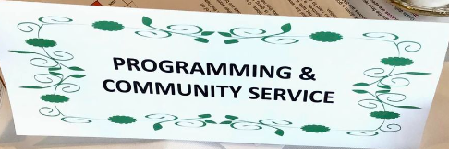
How to Get Started As a Mentor?
A Mentor’s Role
Topics to discuss with the mentee
Additional items
Acquire background information on the mentee (bio, press release, membership application from the sponsor)
Exchange contact information
The mentor contacts the mentee and plans a time (e.g., within 30 days of induction) to get together in person for the purpose of getting to know one another and building a friendship
The mentor sets up a second meeting time to discuss and review Chapter responsibilities and General Chapter information (June-July)
The Links, Incorporated, The Links Foundation
Review relevant websites
Discuss public relations guidelines, e.g. social media posting
Chapter Bylaws
Facet and standing committee assignments
Hostess responsibilities
Chapter financial assessments
Minimum requirement of 48 hours of service
1 in 5 attendance at National Assemblies and Area Conferences and the purpose and rationale for the minimum requirement
Policies and Procedures
Regular check-ins with the mentee after meetings, activities and service projects to clarify questions
Make sure the mentee is assigned to a facet and other committees as applicable with the mentor
When appropriate, seek opportunities to introduce the mentee to other Links

Slide 5
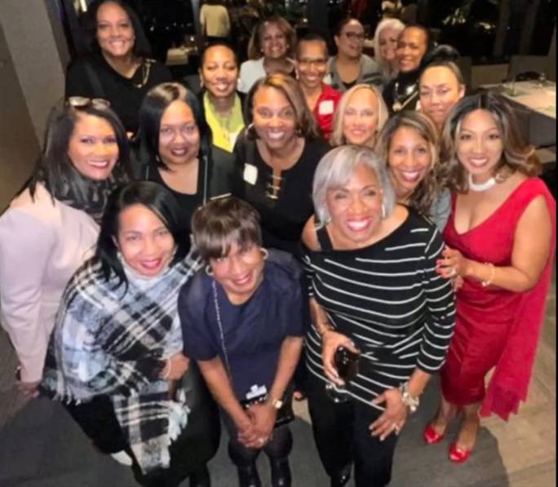
How Can You Help a Mentee?
Once per month communication with your mentee (email, lunch, dinner, phone call, card, etc…)
Keep the commitments to each other-respecting the time commitment of one another
Be willing to make a one-year commitment – extending is optional
Suggested Activities:
Dinner and a movie
Casual lunch plans
Group activity with other new members and mentors
After meeting cocktail or dessert
Attend a play or cultural event
Invitation to special family events (BBQ, etc…)
Plan a special visit to an alumna or member on leave
Attend a class or lecture together
Recognize mentors and mentees at a Chapter meeting
In order to be a mentor and an effective one, one must care. You must care…Know what you know and care about the person, care about what you know and care about the person you are sharing it with” ~ Maya Angelou

Slide 6
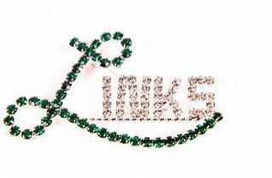
What is the Role of the Mentee?
Respond to the efforts of the Mentor
Pursue and inquire about what she does not understand, ask for help, and remain flexible
Engage new, active and alumna members individually to foster friendship
Attend all meetings, friendship activities, and events
Listen actively and respectfully to the mentor
Demonstrate patience and a willingness to learn
Participate with a positive attitude
Work as a team player
Be receptive to advice as tenure in Linkdom progresses
Initiate regular contact with the mentor, e.g., plan to engage at least monthly and to meet at least quarterly during the first year, engaging in friendship activities such as celebrations, etc…
“We’re here for a reason. I believe a bit of the reason is to throw little torches out to lead people through the dark” ` Whoopi Goldberg

Slide 7
What is the Role of the Mentor vs. Sponsor
The sponsor introduced the inductee to the Chapter and will naturally guide the inductee through her Linkdom experience as needed along her journey with many aspects of membership.
A mentor is a little bit more formal-this relationship allows a little bit more structure to the inductee to ask questions about the orientation material and experience some meetings sitting next to the mentee to cover any specific structural questions in ‘real-time’. It is also a way to have the new inductee meet and establish a new friendship with a new Link by phone chats, and other methods of getting to know one another as schedules permit, such as lunch, dinner, events, etc….
Link Kimberly Keaton-Williams,
Vice President, Membership Chair

Slide 8
Thank You For Continuing the Legacy!
Please contact Link Alecia Ashford-Taylor to volunteer to be a Mentor. ashfordcorp@yahoo.com or text 313.268.1205
Reference the Chapter Website for a list of the new members.
The Detroit Links, Inc
Link Kimberly Keaton-Williams,
Vice President, Membership Chair

