Slide 1

TREASURER’S MONTHLY REPORT – UNRESTRICTED AND RESTRICTED ACCOUNTS
Detroit (MI) Chapter of The Links, Incorporated
APRIL MONTHLY FINANCIAL REPORT 2024
Link Tyra Evans
Detroit (MI) Links Chapter Inc.

Slide 2



DETROIT CHAPTER HAS ZELLE!!!!!
Detroitlinkszelle@gmail.com

Slide 3
Unrestricted Chase Banking Account
OPERATIONS CHECKING ACCOUNTING
Balance Forward, April 1, 2024, Income $45,896.86
Deposit/Credits via Paypal/Zelle – $4,504.81
Total Income and Interest $0.00
Total Brought Forward, Income and Interest $ 50,401.67

Slide 4

Chase Bank Summary

Slide 5
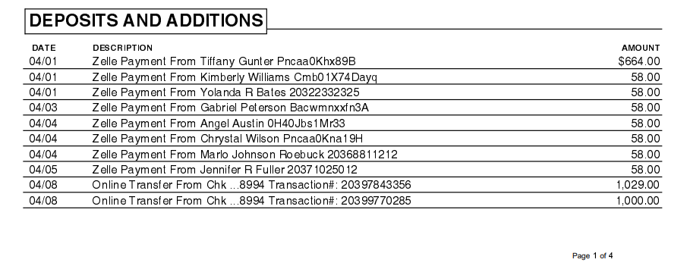
April Deposits
Unrestricted (Ops) Chase Banking Expenses

Slide 6
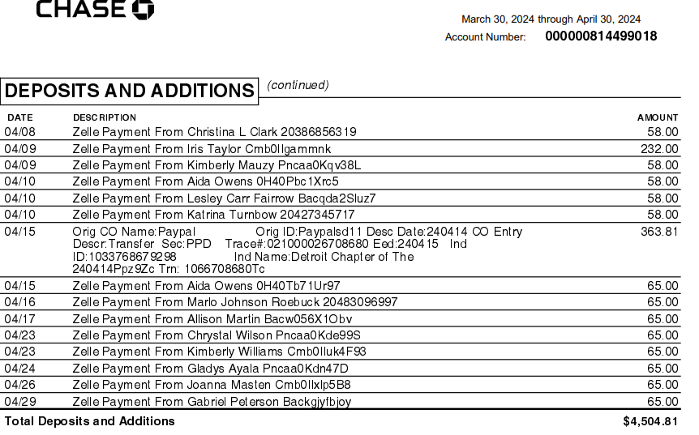
April Deposits
Unrestricted (Ops) Chase Banking Expenses

Slide 7
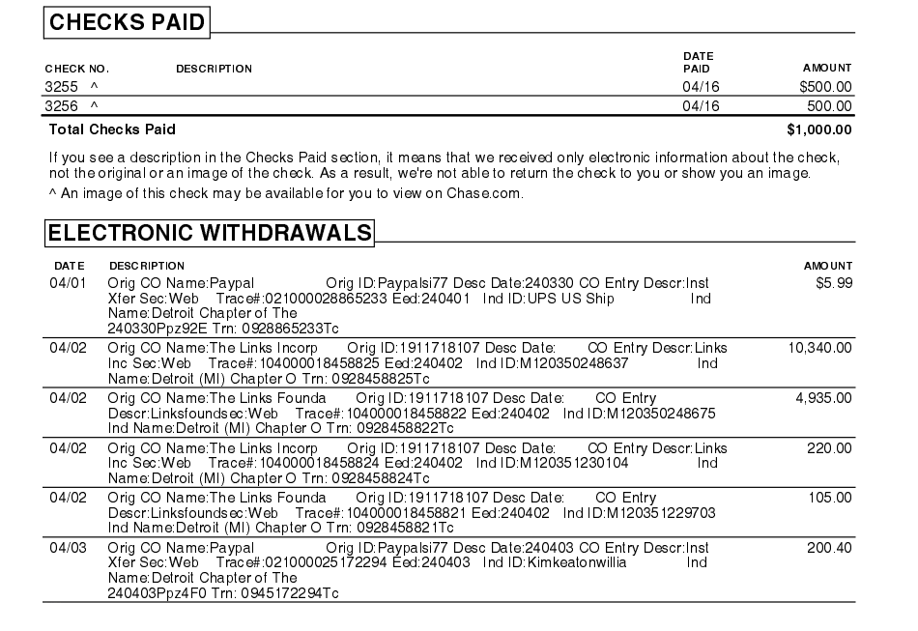
April Expenses
Unrestricted (Ops) Chase Banking Expenses

Slide 8
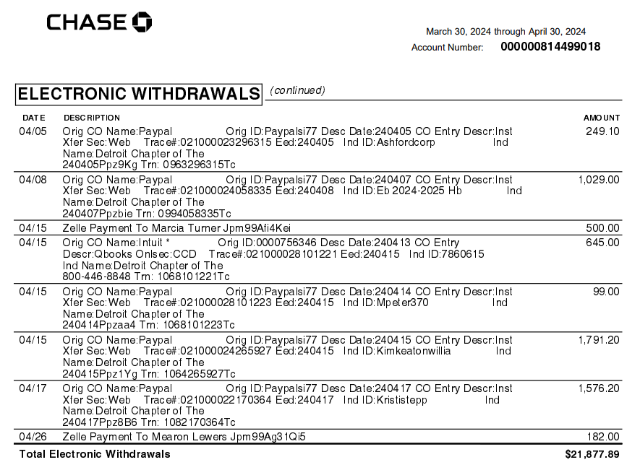
April Expenses
Unrestricted (Ops) Chase Banking Expenses

Slide 9
BALANCE $LESS: 0 Bank Charges $50,401.67
Expenses/Checks incl. PayPal/Zelle – $22,877.89
Bank Balance – April 30, 2024 $27,523.78
Unrestricted Chase Banking Account

Slide 10
Restricted Chase Banking Account
RESTRICTED MONTHLY FINANCIAL REPORT
Balance Forward, April 1, 2024 Income $23,338.61

Slide 11

Chase Bank Summary

Slide 12
No April Deposits
Restricted Chase Banking Deposits
t

Slide 13
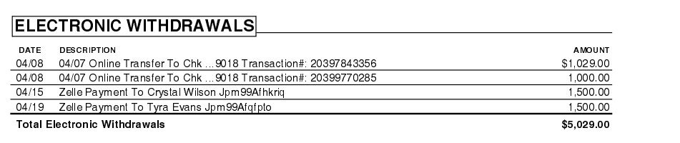
April Expenses
Restricted Chase Banking Expenses

Slide 14
LESS: Bank Charges $0.00
Deposit of $0.00
Balance Brought Forward:$23,338.61
Bank Balance – April 30th, 2024 $18,309.61
Expenses/Checks incl. PayPal/Zelle: $5,029
Restricted Chase account

Slide 15

Upcoming Financial Obligations
March 15-Chapter unrestricted and restricted budgets are due to Area Treasurer
Completed
• April 1 @ 11:59 pm EST Dues are due
COMPLETED
• May 2 -Any individual with unpaid dues are no longer a member of the organization.

Slide 16
National Finance Team’s Priorities
The following 7 workshops will be delivered by the National Finance Team
Overview, Transition and Financial Deliverables –August 22, 2023- COMPLETED
Budgeting and Fundraising –October 2023 COMPLETED
QuickBooks I and II –November 2023 1 COMPLETED
Electronic Voucher with Approval Process and Online- COMPLETED
Financial Deliverables Review –February 2024 COMPLETED
Workshop on Dues Processing and Transitioning –March 2024 COMPLETED
Finance 101, Transition and Financial Deliverables –June 2024 National Assembly COMPLETED

Slide 17


