Slide 1

TREASURER’S MONTHLY REPORT – UNRESTRICTED AND RESTRICTED ACCOUNTS
Detroit (MI) Chapter of The Links, Incorporated
July MONTHLY FINANCIAL REPORT 2024
Link Tyra Evans
Detroit (MI) Links Chapter Inc.

Slide 2



DETROIT CHAPTER HAS ZELLE!!!!!
Detroitlinkszelle@gmail.com

Slide 3
Unrestricted Chase Banking Account
OPERATIONS CHECKING ACCOUNTING
Balance Forward, July 1, 2024, Income $28,470.56
Deposit/Credits via Paypal/Zelle – $1,504.57
Total Income and Interest $0.00
Total Brought Forward, Income and Interest $ 29,975.13

Slide 4
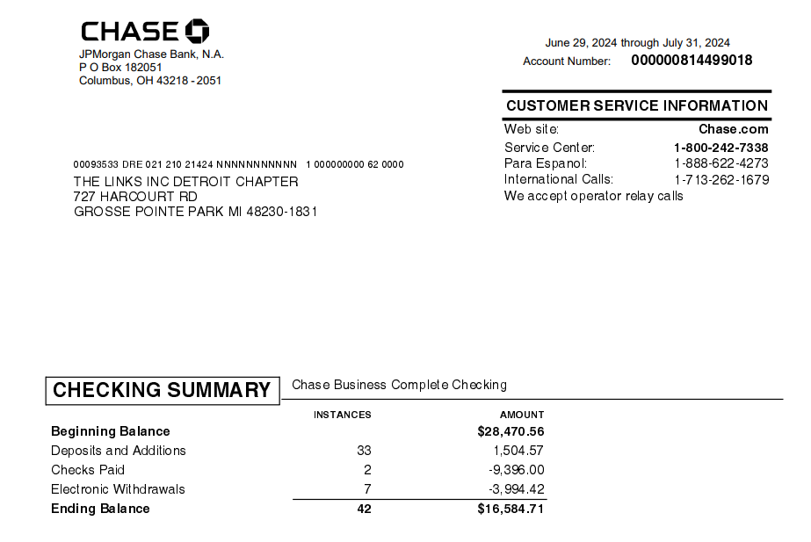
Chase Bank Summary
Deposits: Retreat/name tags
Expenses: retreat/hospitality/fundraiser

Slide 5
Unrestricted Chase Banking Account
BALANCE $29,975.13
Expenses/Checks incl. PayPal/Zelle – $13,390.42
Bank Balance – July 31,2024 $16,584.71

Slide 6
Restricted Account

Slide 7
Restricted Chase Banking Account
RESTRICTED MONTHLY FINANCIAL REPORT
Balance Forward, July 1,2024 Income $27,340.19

Slide 8
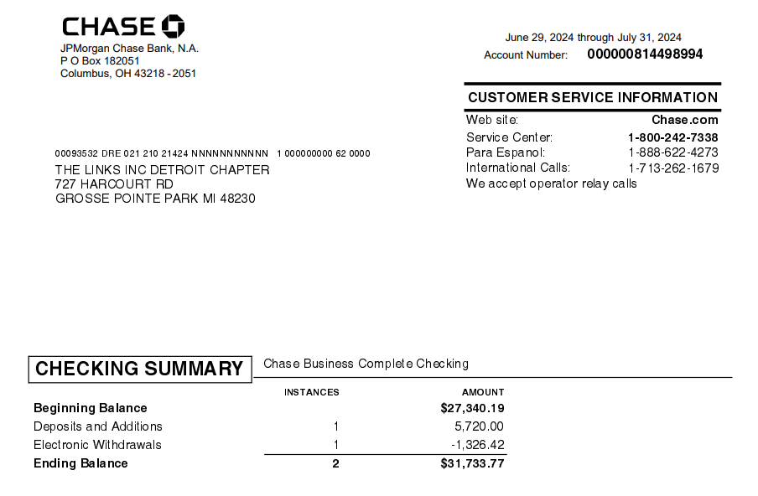
Chase Bank Summary

Slide 9
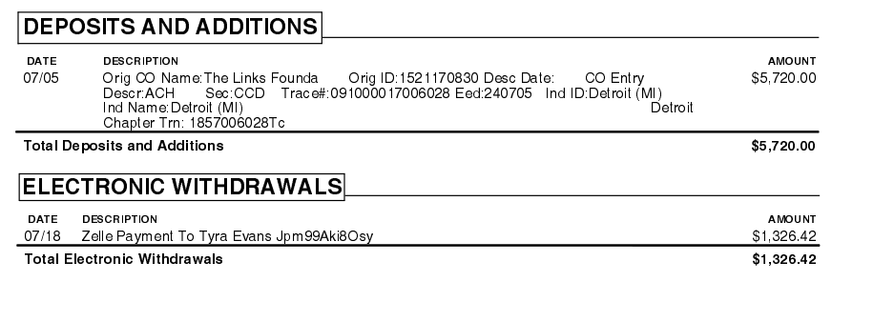
June Deposits/Expenses

Slide 10
Restricted Chase account
LESS: Bank Charges $0.00
Deposit of $5,720
Balance Brought Forward:$33,060.19
Bank Balance – July 31,2024 $31,733.37
Expenses/Checks incl. PayPal/Zelle: $1,326.42

Slide 11


